Slide 1

BI Project
Topic- Ecommerce Sales Dashboard
Submitted to:-
Richa Mathur
Submitted by:-
Harshit Sharma
(Reg. No. -15804)

Slide 2

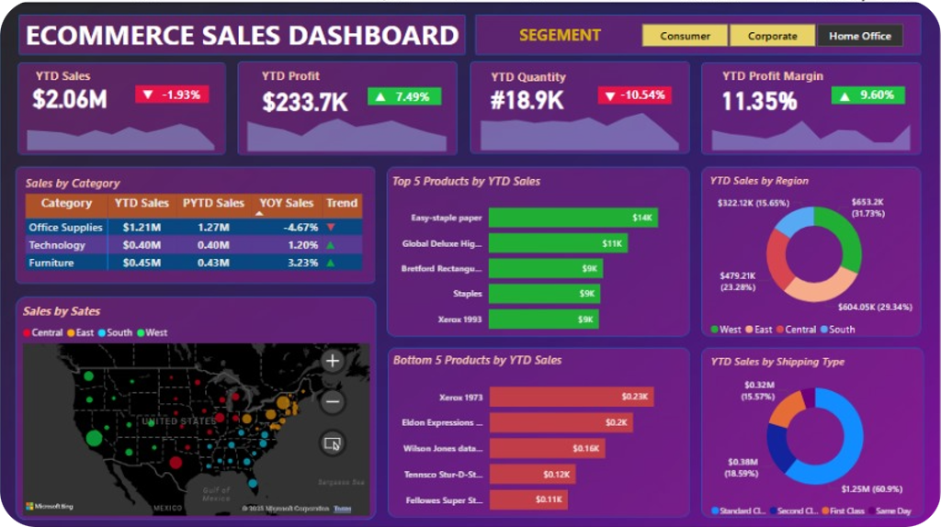
YTD Performance Overview
This presentation provides a comprehensive overview of our year-to-date performance. It highlights key insights across sales, profit, and regional performance. We will also examine top and bottom-performing products, shipping metrics, and strategic recommendations.

Slide 3
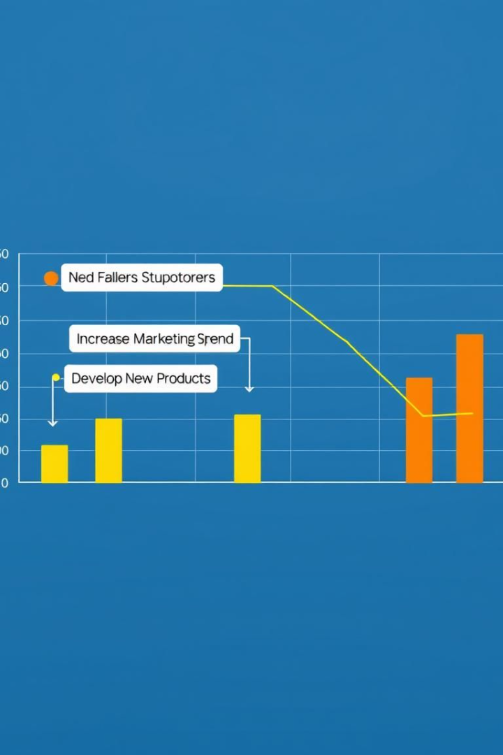
Sales Performance Deep Dive
Sales Overview
Sales reached $2.06M, a slight decrease of -1.93% YTD.
Address the Decline
Focus on high-performing product categories.
Targeted Marketing
Implement campaigns to boost sales and market share.
Analyze Trends
Adjust pricing strategies to remain competitive.

Slide 4




Profit and Profit Margin Analysis
Profit Growth
Profit stands at $233.7K, a healthy increase of +7.49%.
Improved Margin
Profit Margin at 11.35%, a significant +9.60% improvement.
Cost Effective
Cost optimization measures across departments boost profit.

Slide 5
Category Performance Breakdown
Office Supplies
Technology
Furniture
Declining at -4.67%. Increased competition and changing consumer preferences.
Growing at +1.20%. Innovation and demand for new products drive growth.
Growing at +3.23%. Home office setups and design trends are key factors.

Slide 6
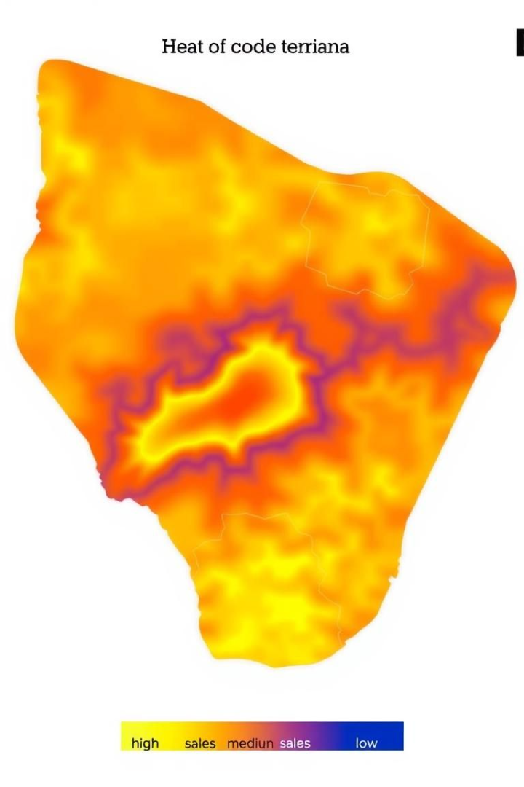




Regional Sales Analysis
West Region
$653.2K, accounting for 31.73% of total sales.
Central Region
$480K (23.3%).
East Region
$450K (21.8%).
South Region
$476.8K (23.17%).

Slide 7
Top and Bottom Performing Products
Top Products
Lowest Products
Easy-staple paper: $14K
Xerox 1973: $0.23K
Global Deluxe Highlighters: $11K
Evaluate and adjust strategies for low-performing products.
Increase promotion for top-selling products.

Slide 8



Shipping Performance
2
Second Day
$500K (24.3%).
Same Day
1
$1.25M, 60.95%.
Standard Class
$225K (10.9%).
3

Slide 9

Strategic Recommendations
High-Growth Categories
Targeted Marketing
Optimize Product Mix
Focus on Technology and Furniture sectors for expansion.
Implement campaigns in Central and East regions to boost sales.
Enhance overall sales and profitability through careful product selection.

